Slide 1
FLIGHT TICKET PRICE SCAPPER
Group No: 5
Tarun Raveesh : AM.EN.U4CSE20016
Shoaib Akhtar: AM.EN.U4CSE20163
Chetan Anand: AM.EN.U4CSE20219

Slide 2
What is web scraping?
Web scraping uses intelligence automation methods to get thousands or even millions of data sets in a smaller amount of time.
Here's an overview of how web scraping works:
Request: A web scraper sends HTTP requests to a specific URL, requesting the web page's content.
Download: The web server of the target website responds by providing the HTML code of the requested page.
Parsing: The web scraper parses the HTML content to extract the data of interest. This can include text, images, links, and structured data like product prices or stock market information.
Data Storage: The extracted data is typically stored in a structured format, such as a database, CSV file, or spreadsheet for further analysis or use.

Slide 3
INTRODUCTION
SELENIUM
Selenium is a popular open-source framework and a suite of tools used for automating web browsers.
It provides a way to script interactions with web browsers, allowing you to automate tasks like filling out forms, clicking buttons, navigating through web pages, and extracting data from websites.
Selenium is commonly used for web application testing, web scraping, and automating repetitive tasks involving web browsers. It supports multiple programming languages such as Python, Java, C#, and more, making it a versatile choice for web automation and testing.

Slide 4
INTRODUCTION
CHROME DRIVER
A ChromeDriver is a standalone server that facilitates communication between your Selenium test scripts and the Google Chrome web browser. It is a component of the Selenium framework and is used to automate interactions with the Chrome browser.
ChromeDriver essentially acts as a bridge, receiving commands from your test scripts (which are typically written in languages like Python, Java, or C#) and translating those commands into actions within the Chrome browser.
By using ChromeDriver along with Selenium, you can perform web automation, web scraping, and testing on the Chrome browser. This combination is a common choice for automating web-related tasks due to its versatility and support for various programming languages.

Slide 5
Challenges in Web Scraping Using Local Browsers
IP Blocking
Websites can detect and block IP addresses making abnormal requests.
Local browsers use a single IP, making them susceptible to blocking.
Rate Limiting
Many websites impose rate limits on requests from the same IP.
Exceeding these limits can lead to blocked or slowed-down scraping.
Lack of Proxies
Scraping with a single IP makes detection easier.
A proxy pool allows requests from different IPs, reducing detection risk.
CAPTCHA Challenges
Websites use CAPTCHAs to verify users as humans.
Local browsers struggle to solve CAPTCHAs automatically, posing challenges.
Dynamic Website Content
Modern websites load content dynamically using JavaScript.
Local browsers may not scrape accurately due to delayed content loading.

Slide 6
Data collection process
1. Discover all website pages
To discover an entire list of a products within a category or the entire website, you’ll need to run a discovery phase. Use ready made functions for the site search, such as:
Data extraction from lazy loading search (load_more(), capture_graphql())
Pagination functions for product discovery
Support pushing new pages to the queue for parallel scraping by using rerun_stage() or next_stage()
2. PDP - Product details page
Build a scraper for any page, using fixed URLs, or dynamic URLs using an API or straight from the discovery phase.
HTML parsing (in cheerio)
Capture browser network calls
Scrape the website JSON APIs

Slide 7
Data collection process
3. Data validation
A crucial step ensuring you’ll receive structured and complete data
Define the schema of how you want to receive the data
Custom validation code to show that the data is in the right format
Data can include JSON, media files, and browser screenshots
4. Data delivery integrations
Deliver the data via all the popular storage destinations:
API
Amazon S3
Webhook
Microsoft Azure
Google Cloud PubSub
SFTP

Slide 8
Bright Data Collector: Key Features
Simplify your web scraping efforts using the no-code platform of Bright Data Collector.
You will get pre-made coding templates and functions in the hosted solution of Bright Data. This will make it easier to create a web scraping tool easily at scale.
Bright Data Collector uses AI algorithms to seamlessly match, clean, process, structure, and synthesize the unstructured data of a site before delivery.

Slide 9
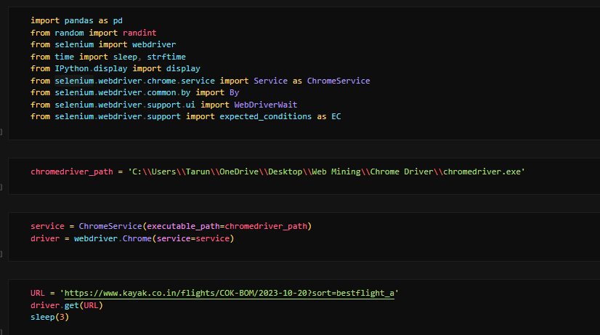
WORKING WITH SELENIUM

Slide 10
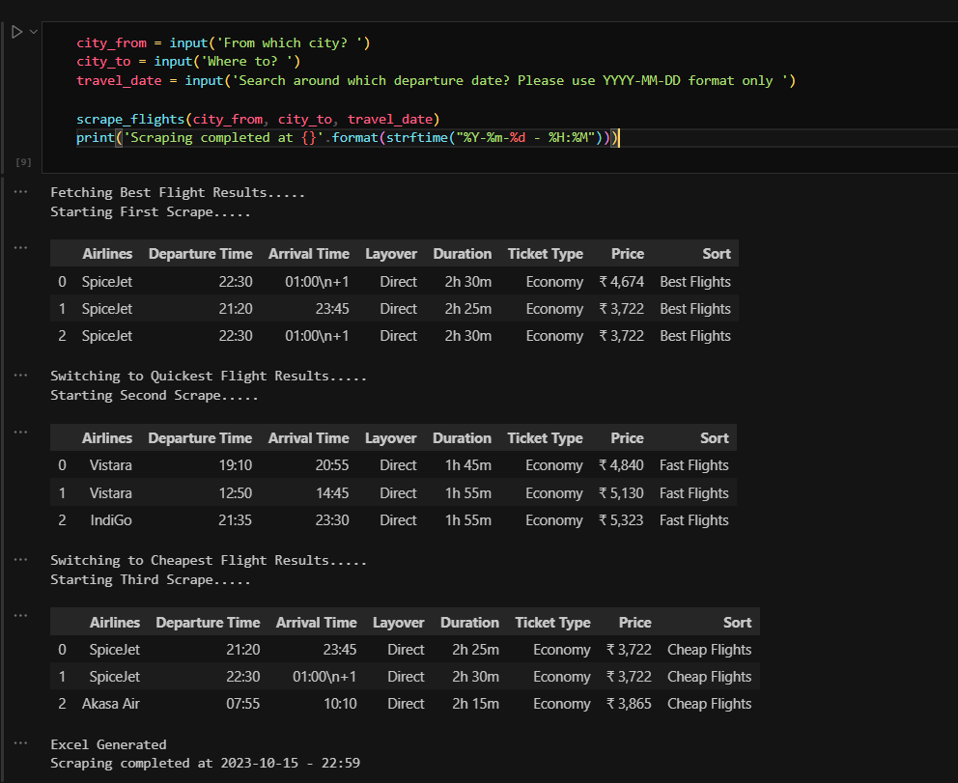
WORKING WITH SELENIUM

Slide 11
THANKS

